Slide 1
YCH Group Co.,Ltd.

Slide 2
YCH Group co., ltd. Profile
Establish 2010
Value 2M USD/ Year
20 Person Staff
ISO9001 Certificate
More than 100 Thailand Client Support
Oversea support Korea, Malaysia, Vietnam, Egypt, Myanmar etc
Pharmacy, Toothbrush, Food, Condom, Consumer, etc

Slide 3
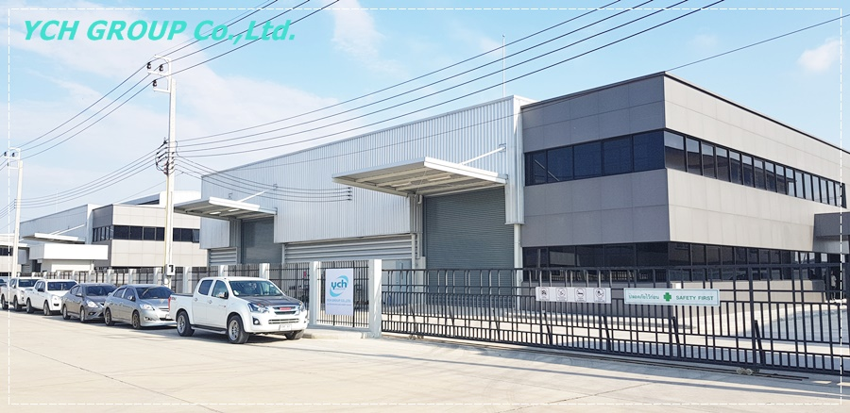
YCH Group co.,Ltd. Factory

Slide 4
YCH Group co.,Ltd. Staff

Slide 5
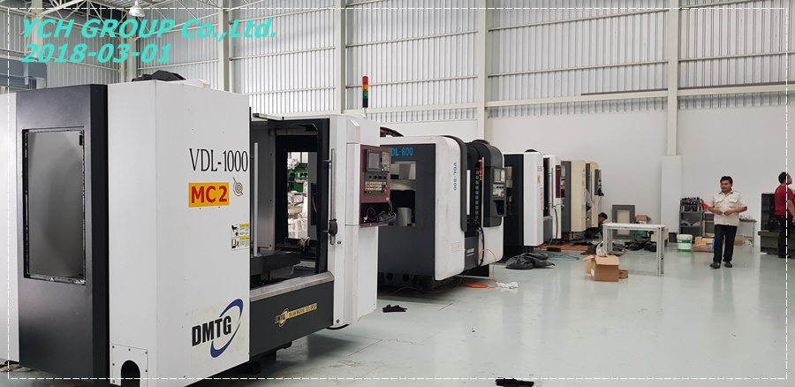
YCH Group co.,Ltd. Machine

Slide 6
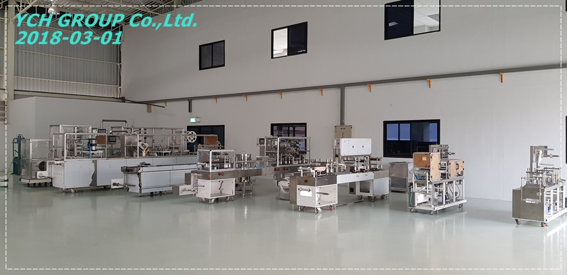
YCH Group co.,Ltd. Machine Assembly line

Slide 7
CAM+SERVO GRIPPER DRIVEN BLISTER TYPE
CHAIN GRIPPER BLISTER TYPE
THERMOFORMING PACKING MACHINE
PHARMA AND MEDICAL INDUSTRIES
YCH Group co.,Ltd. Products

Slide 8
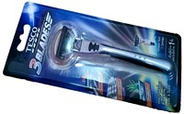
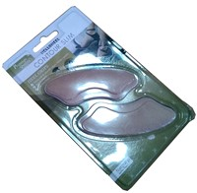
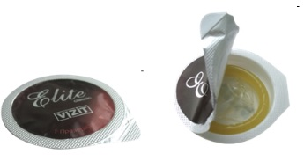
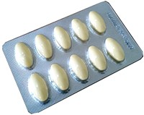
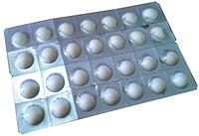
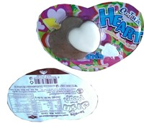
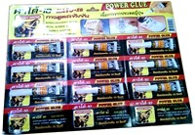
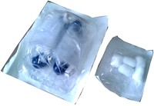
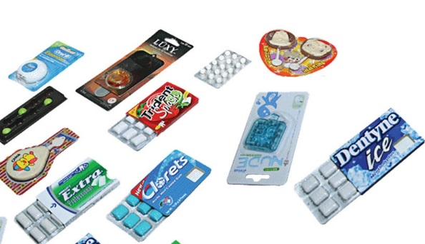
Medicine
Medicals equipment
Cosmetics
Consumer products
Condom
Toothbrush
etc
Products Samples

Slide 9
Blister Packing machine Model 2014

Slide 10
Cartoner Packing machine Model 2018

Slide 11
Toothbrush Blister Packing machine Model 2015

Slide 12
Toothbrush Blister Packing machine Model 2014

Slide 13
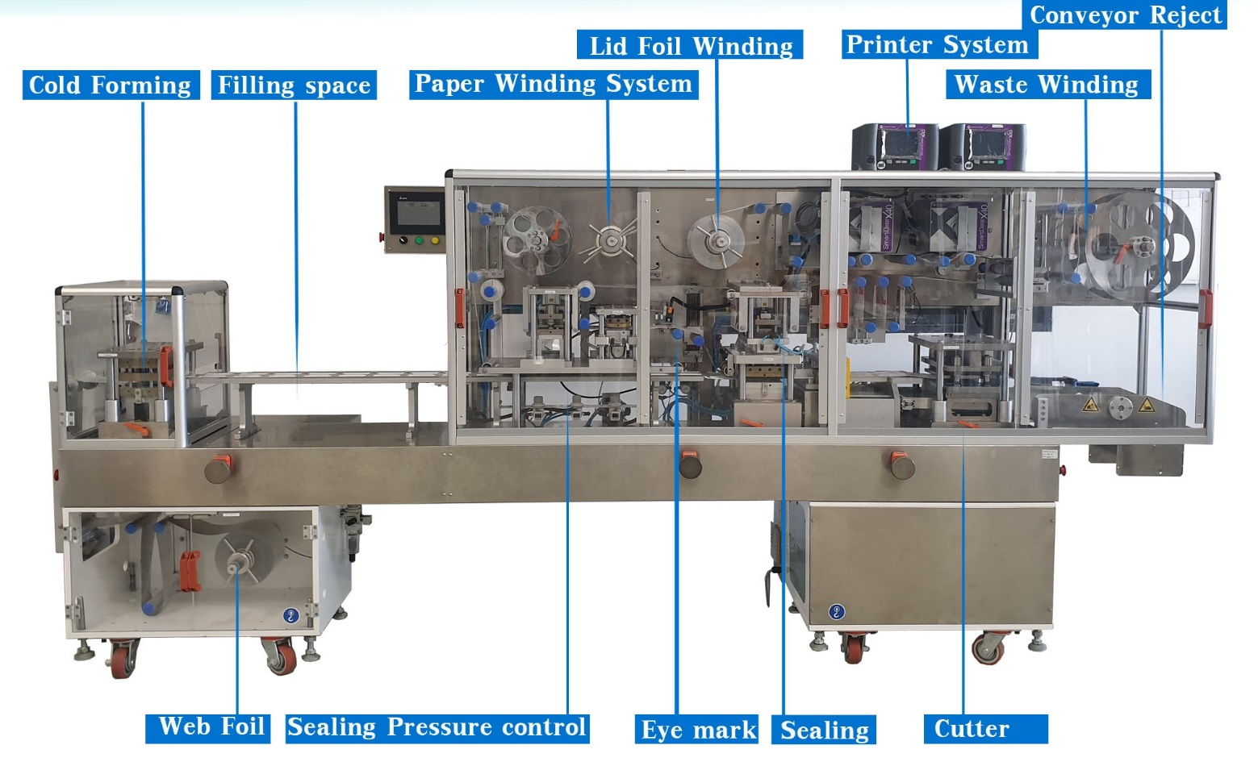
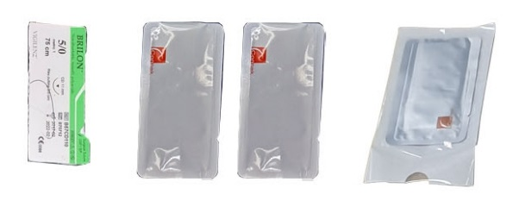
ALU ALU Suture Packing machine Model 2018

Slide 14
Thermoforming Packing machine Model 2015

Slide 15
Island Blister card Packing machine Model 2019

Slide 16
EXHIBITION FAIR

Slide 17
Machine

Slide 18
Olic thailand co.,ltd.
Macrophar co.,ltd.
Siam medicare co.,ltd.
Continental pharm co.,ltd.
Thai Herbal Products co.,ltd
Meng seng sweet factory co.,ltd.
Acdhon drug co.,ltd.
Giffarine skyline laboratory & health care co. ltd
SEVEN STARS PHARMACEUTICAL CO.,LTD.
The Medicpharma Co.,Ltd.
Thai nippon Co., Ltd.
The Medicpharma Co.,Ltd.
OSOT INTER LABORATORIES CO.,LTD
BRT Corporation Co., Ltd. (KOREA)
PARA-SCIENCE RESEARCH CORP.,LTD.
AMAZING GRACE Co.,LTD.
B.L.HUA CO.,LTD
Sukij55 co.,ltd.
Pharma Sant Laboratories Co.,ltd.
SRIPRASIT PHARMA CO.,LTD.
DKSH
Nature agro products co.,ltd
GENSIGN RESEARCH COMPANY LIMITED
YEE SHIN Co.,Ltd. Myanmar
Pharmaceutical Customers

Slide 19
Export Oversea

Slide 20
YCH Group Co.,Ltd.
888/2 GREENPARK3 SAMAKKEESAMREJ RD.
T.BANGSAOTHONG A.BANGSAOTHONG
SUMUTPRAKARN THAILAND 10540
TEL +6621307171-3
FAX +6621307174
WWW.YCH-GROUP.COM
YCH@YCH-GROUP.COM

